Slide 2
COVR-Award – DOROTHY – Milestone 2
Awardee: DARPAMotion Ltd, Budapest University of Technology and Economics
Award title: DOROTHY (Dual cobot system for safe motion therapy)
  M2 Delivery Date: M16 (16.08.2021)
  M2 Content (from Annex 1)
    The third objective is to develop a test method and apparatus for quantification of a selected RACA safety feature.
    The fourth objective is to measure, process and store the safety feature related data.
    D2.1 RACA standard conform test protocol for quantitative evaluation of a dominant safety feature based on the hazards and risks identified in D1.1 for which no appropriate testing protocol is available in the field. The deliverable will include a description of test method and apparatus
    D2.2 Electronic repository of measured data, including report specifying location/access to repository and description of (meta) data of stored safety feature-related data.

Slide 3
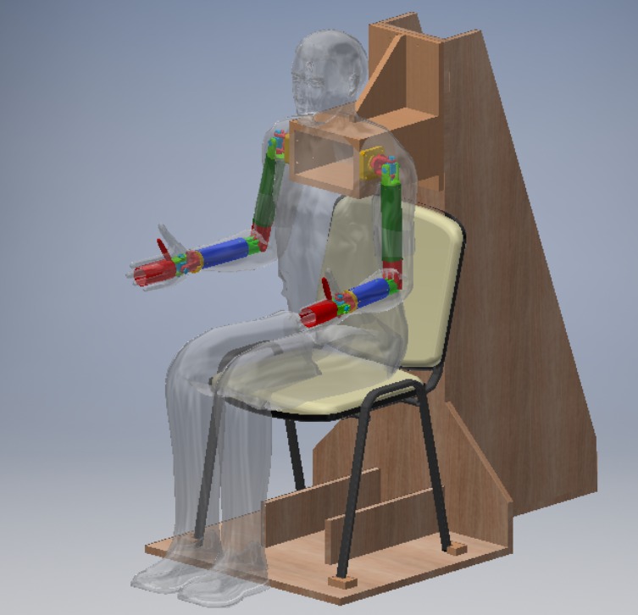
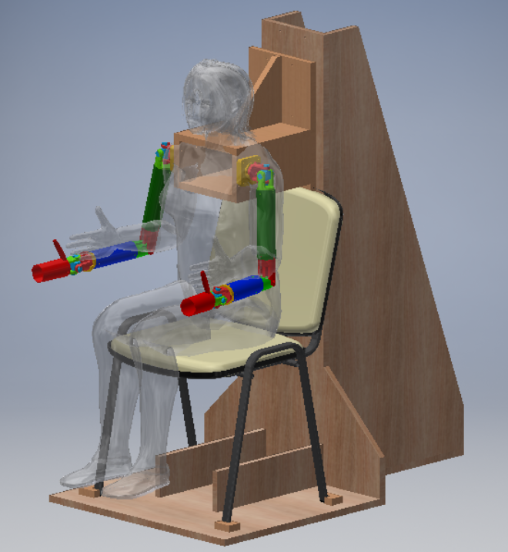
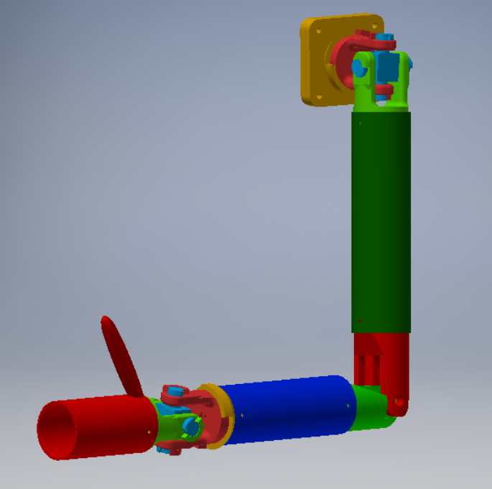
DOROTHY test method and apparatus: dummy upper limb
Sitting posture limb size range between
  5 %ile female
  95 %ile male
Trunk enclosure can be set to
  size
  left-right side
Dummy limb can be set to
  size
  (replaceable green,
  and blue tubes)
  left-right side
7 DOFs

Slide 4
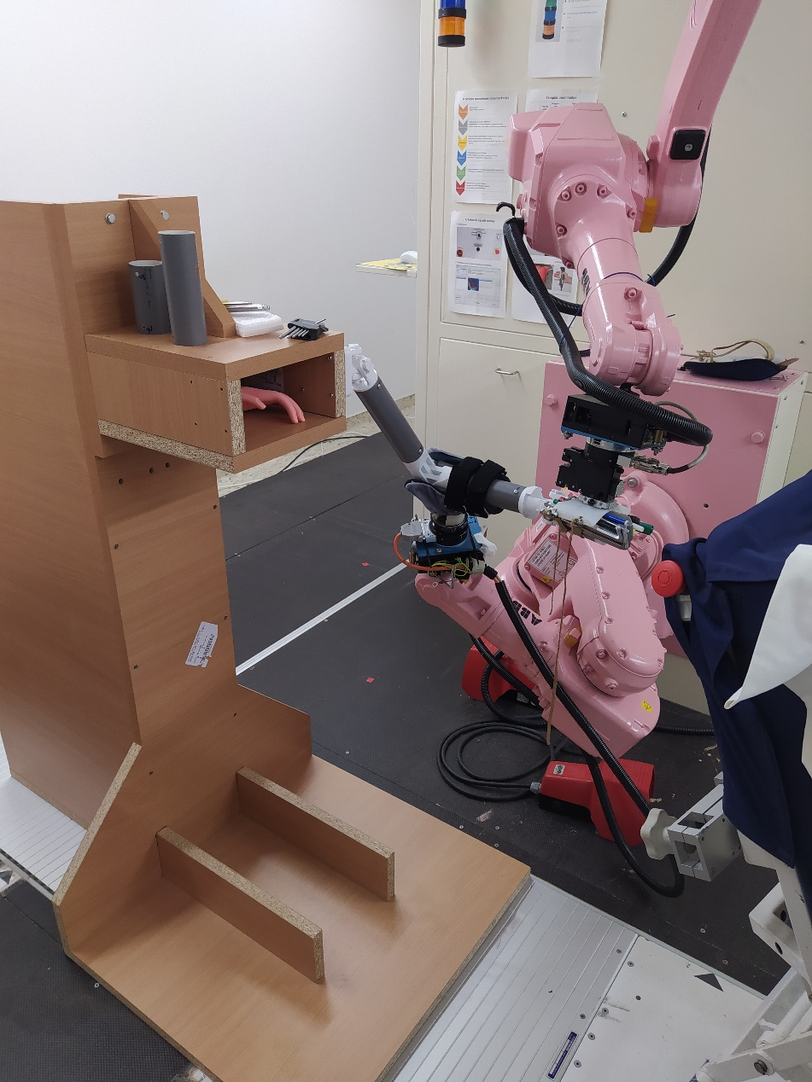
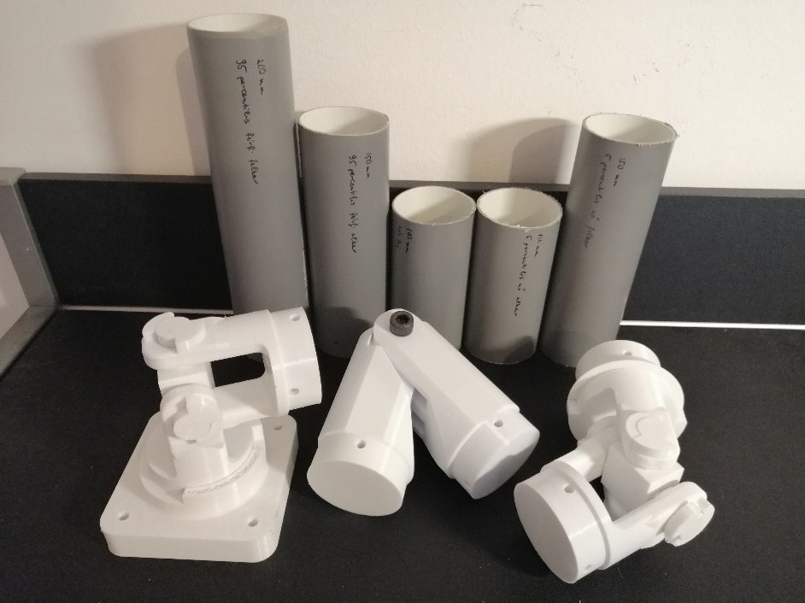
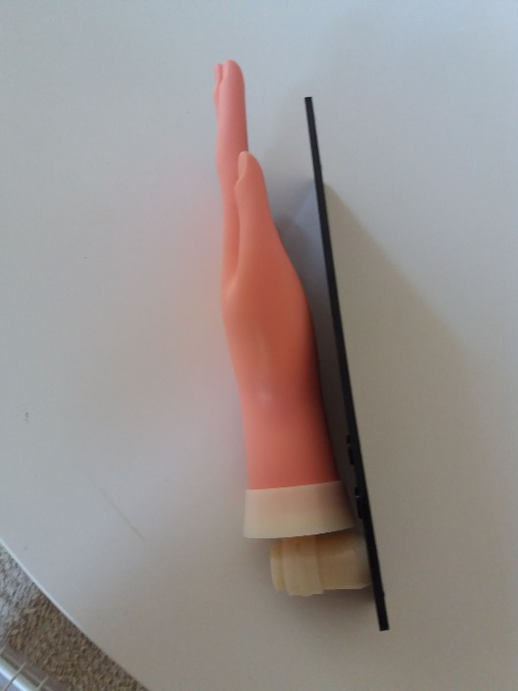
DOROTHY Dummy limb #1
The elbow and the shoulder joints were also 3D printed
PVC drain tubes were cut to hand, lower arm, and upper arm lengths
Cosmetic hand to be added
Functional testing

Slide 5
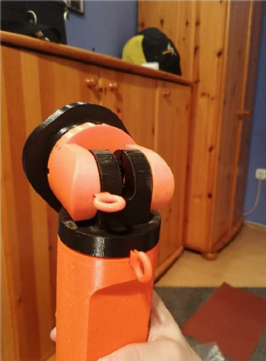
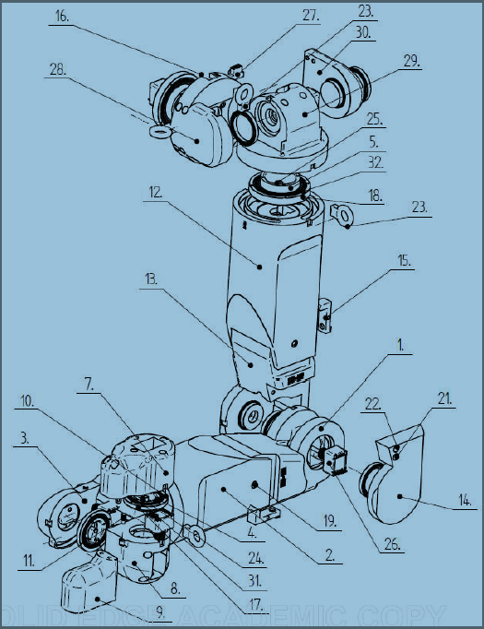
DOROTHY Dummy limb #2
Joint encoders and data processing card
Aluminium bushings
Rolling bearings
Cable routed inside
Adustable arm lengths
Zero offset and brake plugs
Left-right change buttons
Notes:
5

Slide 6
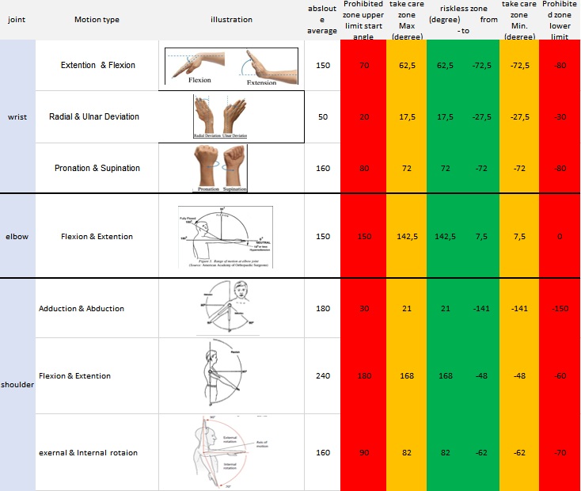
„DOROTHY” COVR protocol
Joint limit risk:
  zone1: riskless
  zone2: take care (5-5% of the full range)
  zone3: prohibited
Notes:
6

Slide 7
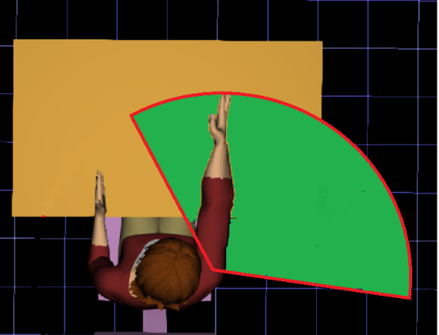
„DOROTHY” COVR protocol
Overreaching risk:
  If elbow is near 0 deg
  OR
  If wrist flex-ext is near 0 deg
  OR
  If wrist rad-uln dev is near 0 deg
Notes:
7

Slide 8
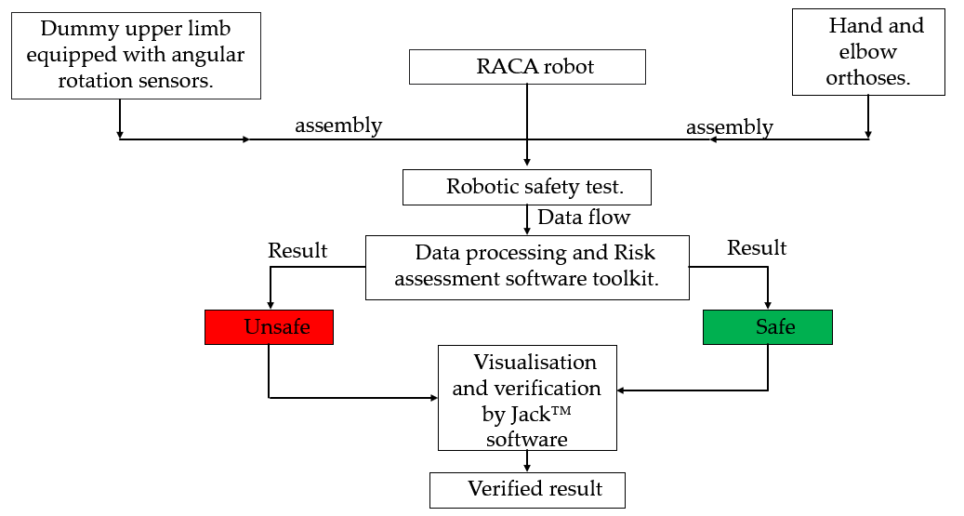
Test Plan
Hand and elbow orthoses.
Notes:
8

Slide 9
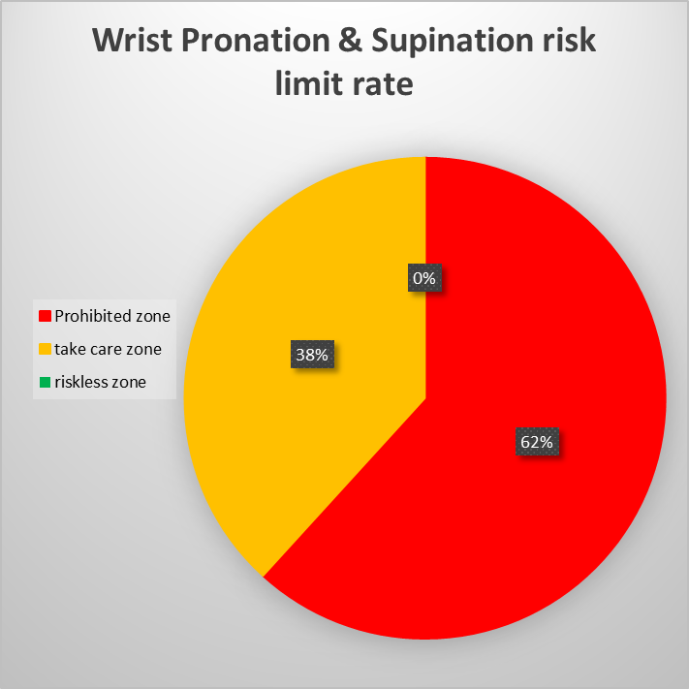
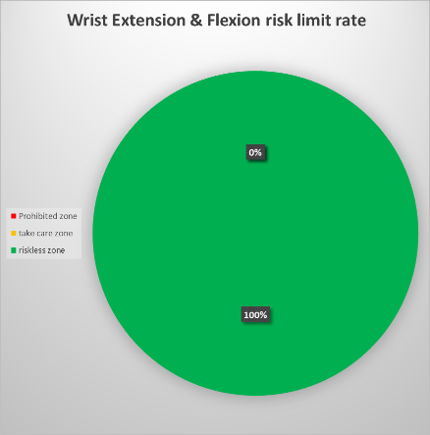
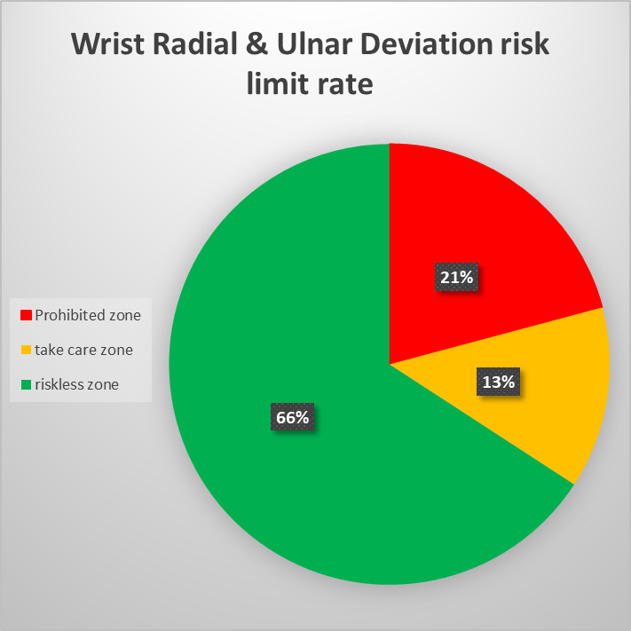
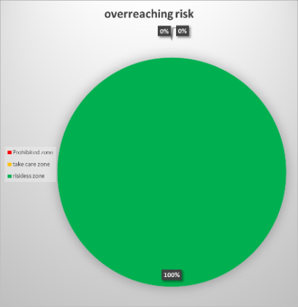
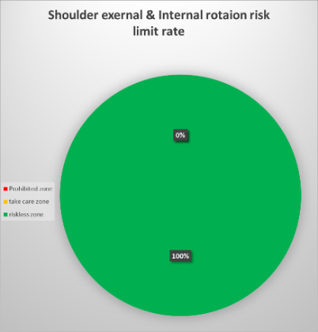
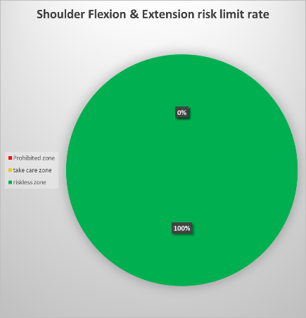
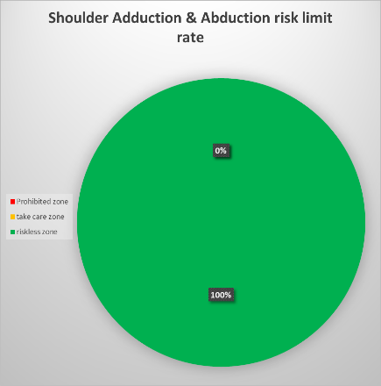

DOROTHY COVR Protocol:
Numerical and Graphical Test Reports
Notes:
9

Slide 10
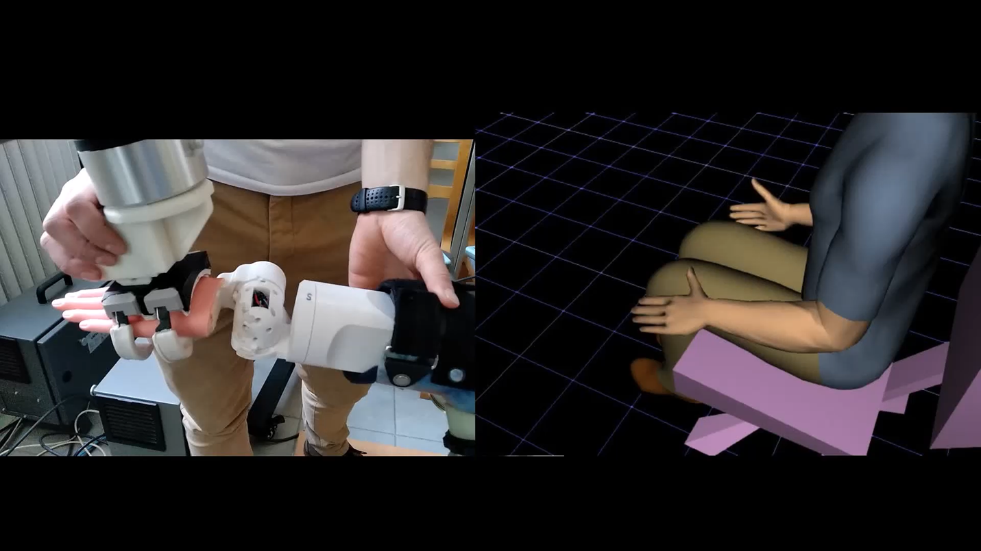
Data visualisation by Jack™ software
(video to compare between the movement of real test and visualisation software)
(vi
Notes:
10

